Slide 1
MyCompany.com
Group1, July 2014
Group members:
James
Va Yim
Yogendra
Talak
Weldu
Md Mojahidul

Slide 2
Documentation
Scope and scope details
Requirement gathering
Integration plan
Change request
Functional specifications
WBS
Schedule
UTP
Class-diagram and ER-diagram

Slide 3
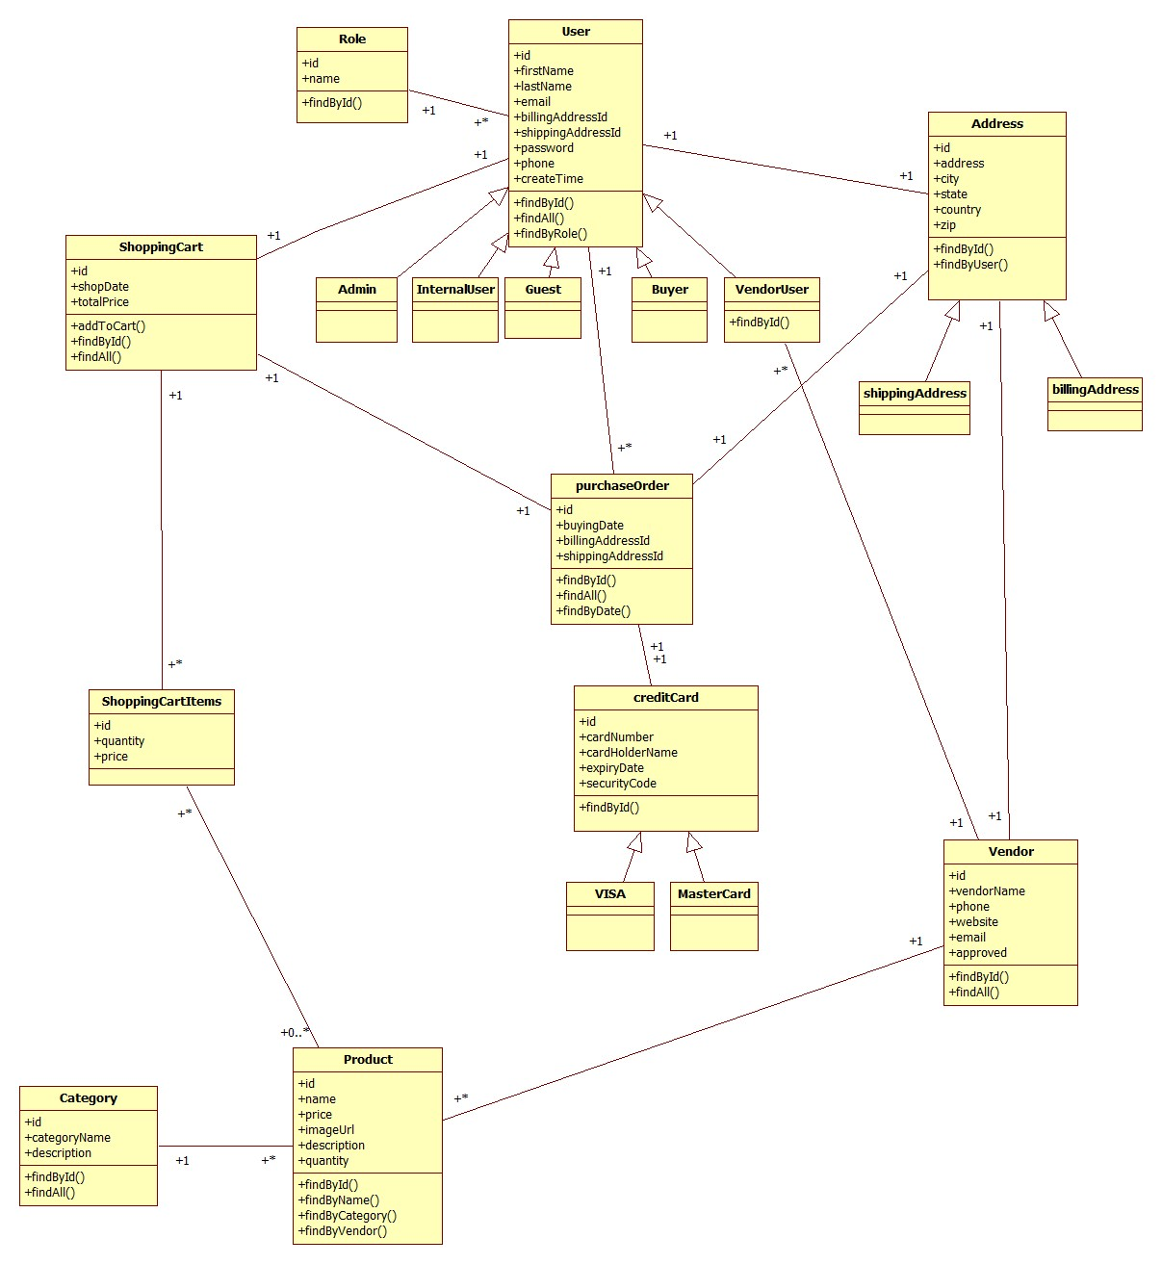
Design: Class diagram

Slide 4
WORK IN PROGRESS
Notes:
The graph show how much %work is completed in phase1 and remaining in phase2

Slide 5
Check out phase1 second iteration
Put the hyper link here??

Slide 6
Time is a major risk
RISK MANAGMENT
RISK | IDENTIFIED BY | DATE | ANALYSIS | RESOLVE | ALTERNATIVE | BACK-UP | LESSONS LEARNED
Time | Team | 07/09/2014 | ?? | No | None | Working day and night | ??
No automatic integration of the project works | Talak | 07/10/2014 | Maven setup error | No | Manual sharing of codes | - | ??

Slide 7
SCI
Software development is done by following laying structure like MVC pattern
Life is found in layers.

